Slide 1
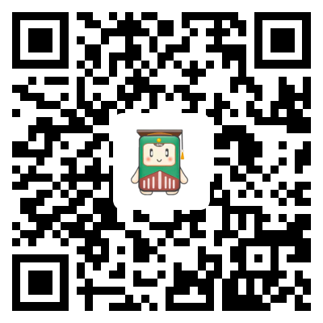

Android Final Project
“掌上通通”(My Tongtong)
Present by：Liang Deng | Zihan Zhou | Junze Li | Zihan Xu | Zicheng Xu | Rui Xing

Slide 2
CONTENTS
Demand Analysis
Idea & Difficulties
Solution
demonstration
Summary
Background
Motivation
Idea
Difficulties
Solution
System architecture
Function
Work flow
UI
robustness
Demo
Experiment
Summary
Percentage
Future

Slide 3
01
Demand Analysis

Slide 4

Background
01
Where is the study room???
02
What class am I having today???
03
Where to say something in my heart???
Several HEADACHES in college life
04
……

Slide 5
Motivation
Motivation
Use mobile development technology to make our college life better and better.

Slide 6
02
Idea & Difficulties

Slide 7
Idea
“掌上通通” (My Tongtong)
To achieve our requirements easily.
A campus platform integrating classroom query, timetable query, sports and tree hole.

Slide 8

Idea
01
03
Classroom Query
Free self-study classroom query
Tree hole
Say what you want without personal label
02
04
Class Schedule
My weekly class schedule
Step Count
Compare your steps with friends

Slide 9

Difficulties
Encapsulation of the network
Storage of data objects
Design and implementation of interface layout
User data management
User resource cache
Design and organization of platform architecture

Slide 10
03
Solution

Slide 11
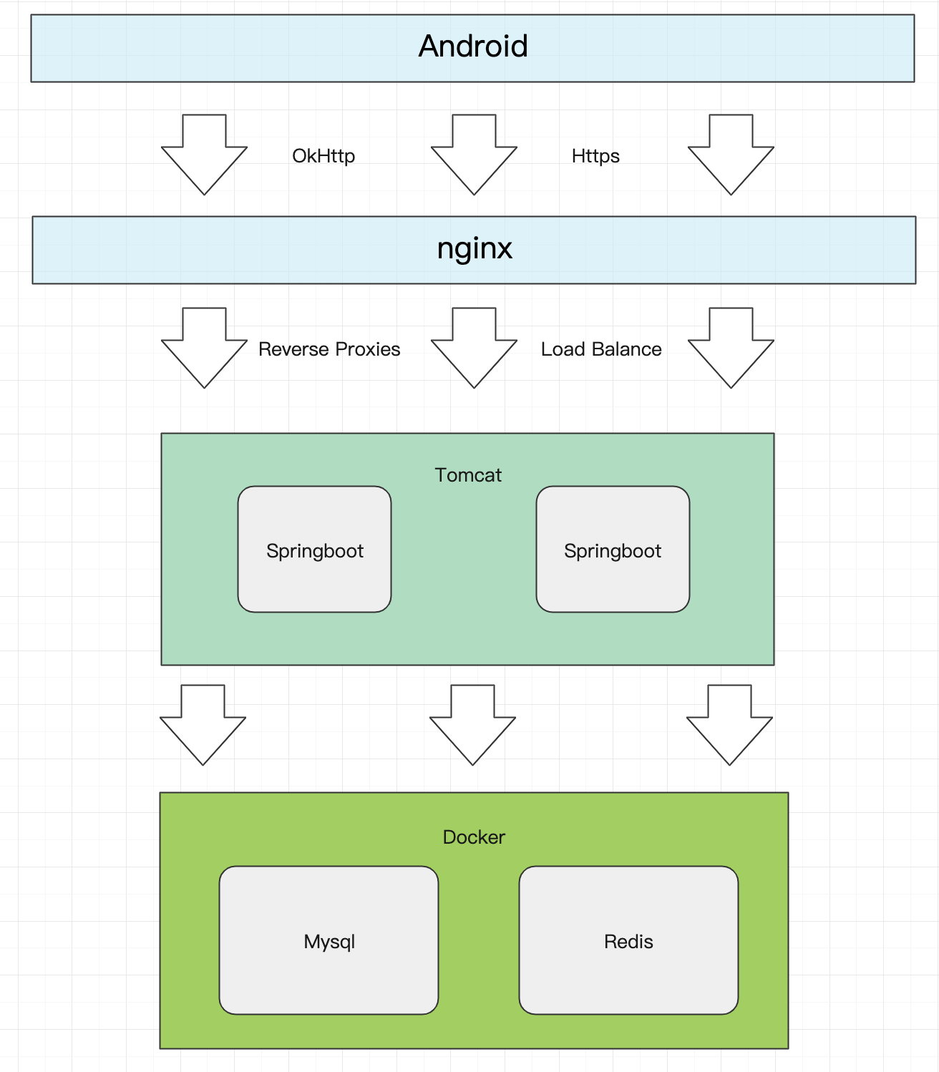
System structure

Slide 12
Functions
My Tongtong
User
Classroom
Timetable
Tree Hole
Step Count
register
display
display
display
Monitor
detection
Log
in
Add class
Send message
Data
storage
Modify background
Delete class
Rank
display
Modify avatar

Slide 13
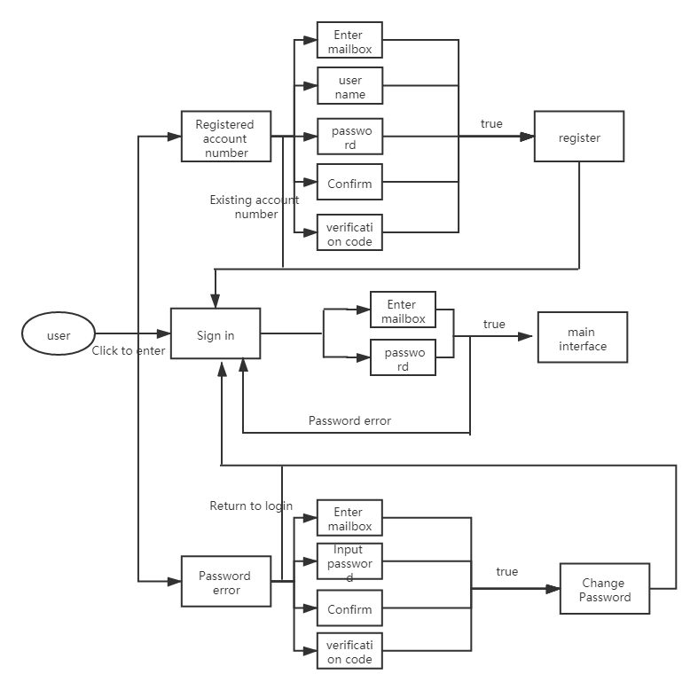
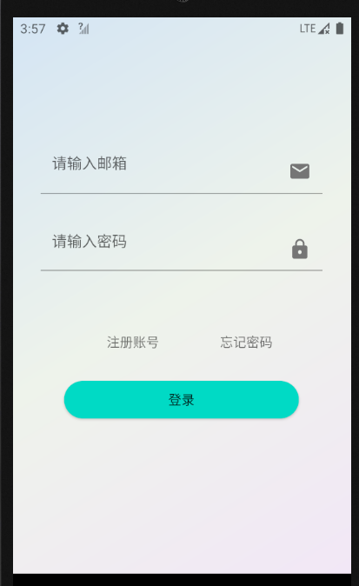
Work flow
Login
1. Register.
2. Login.
3. Forget the password.

Slide 14
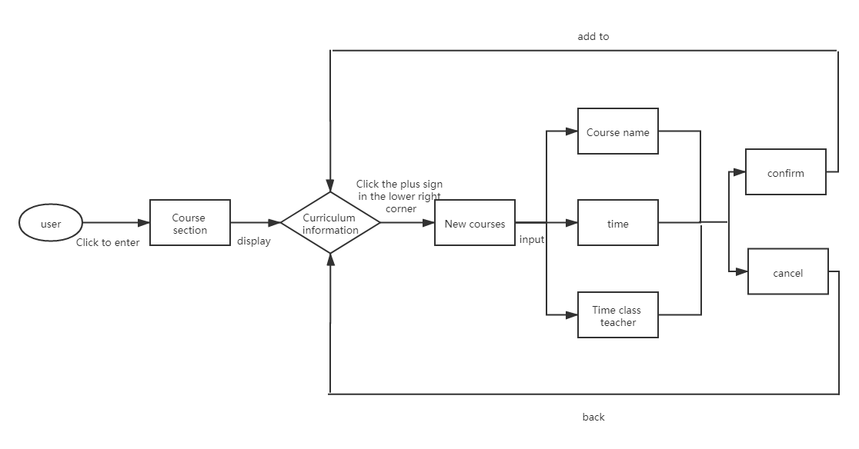
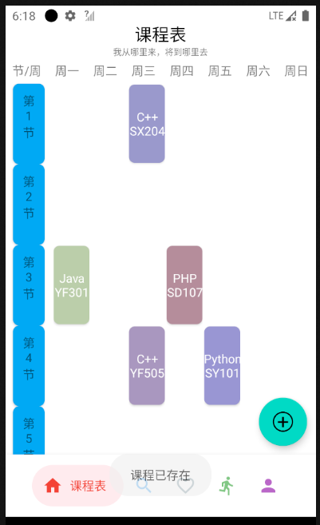
Work flow
Class schedule
Enter the class list interface.
Click the floating button to add class.
Press and hold a class to delete class.

Slide 15
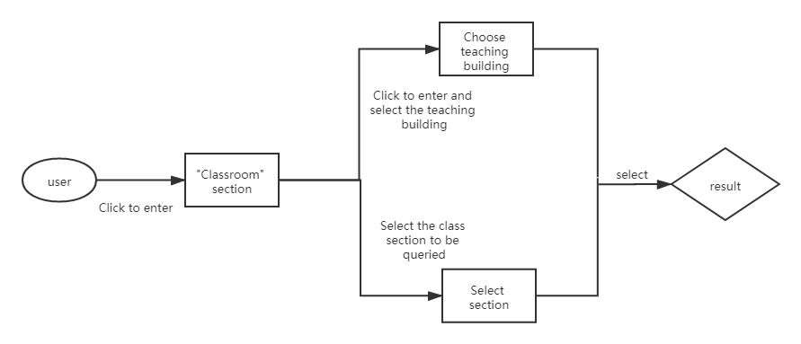
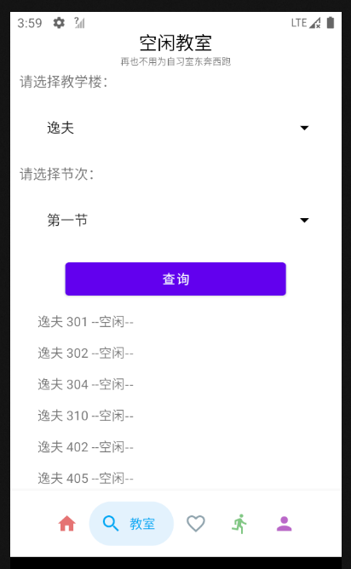
Work flow
Spare classroom query
1. Enter interface to select.
2. Select the teaching building.
3. Select which class.

Slide 16
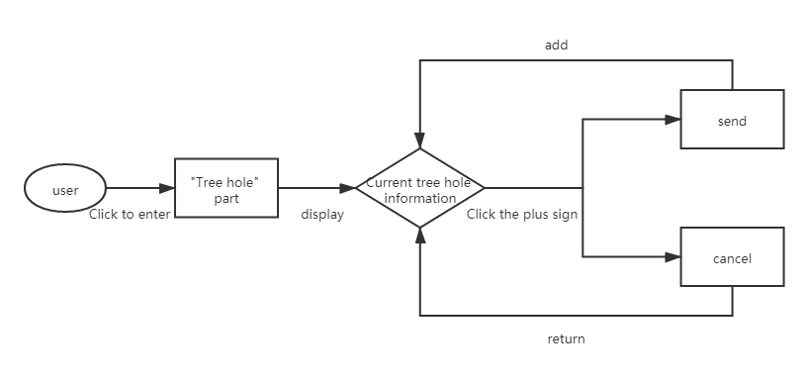
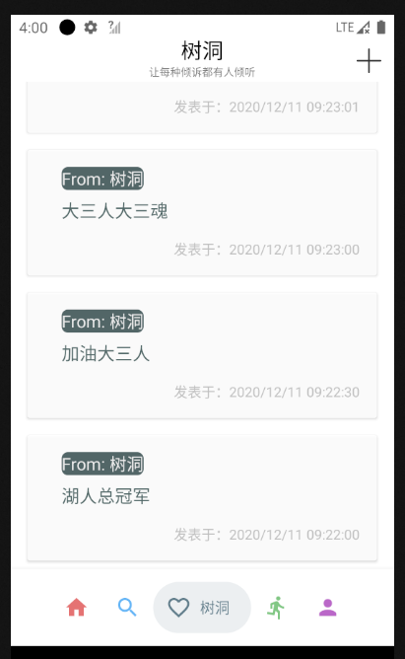
Work flow
Tree hole
1. Enter interface to select.
2. Click the “plus” sign.
3. Enter the content and send.

Slide 17
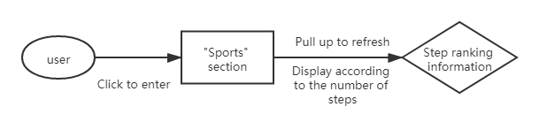
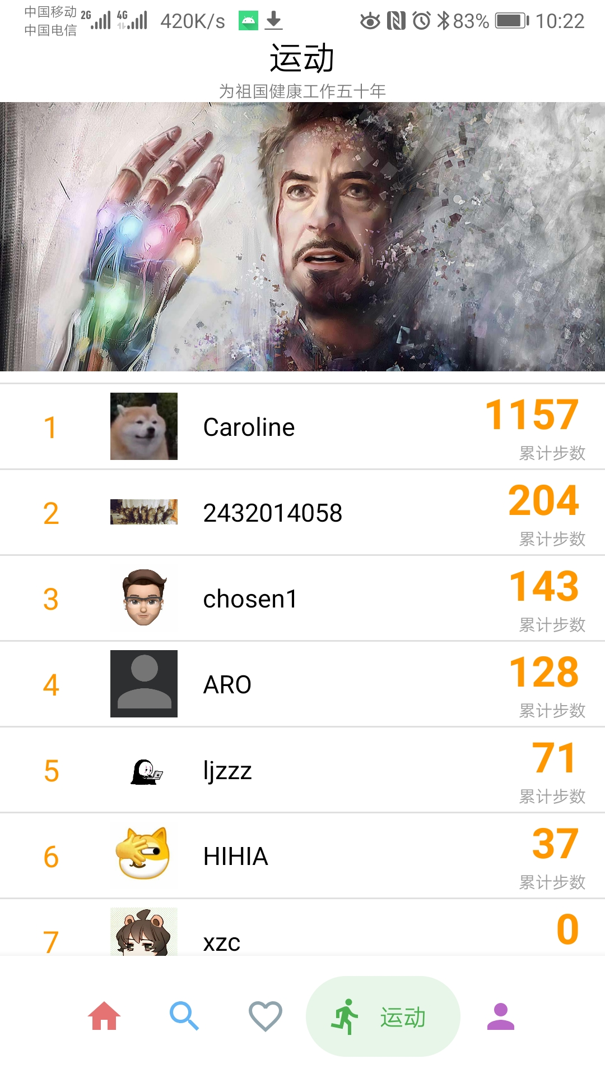
Work flow
Steps
View step ranking.

Slide 18
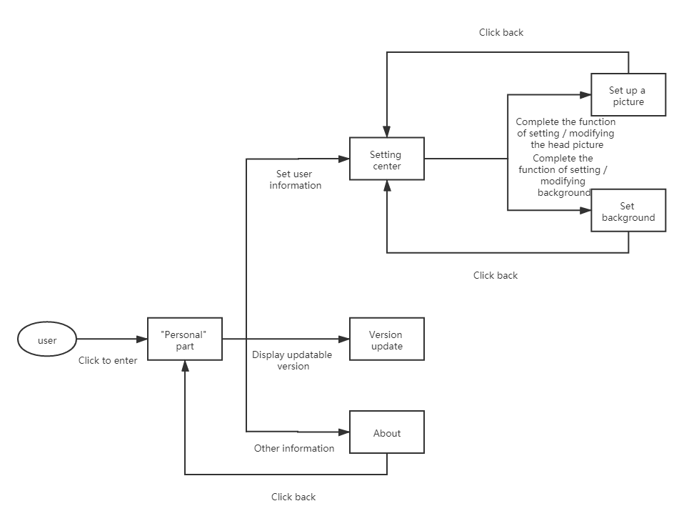
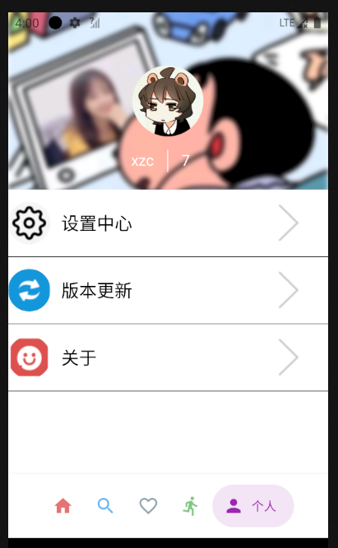
Work flow
Personality
Enter the personal interface .
Changing background and picture in setting center .
3. Glancing over version update and “about” information .

Slide 19
Technology
Cache
3. Object Storage Service
Permission requirement
Animation
Float button
11. ListView
2. Sensor step counter
4. BGA Refreshing Layout
Blowfish encryption algorithm
Intent
10. CardView
12. ……

Slide 20
04
Demonstration

Slide 21
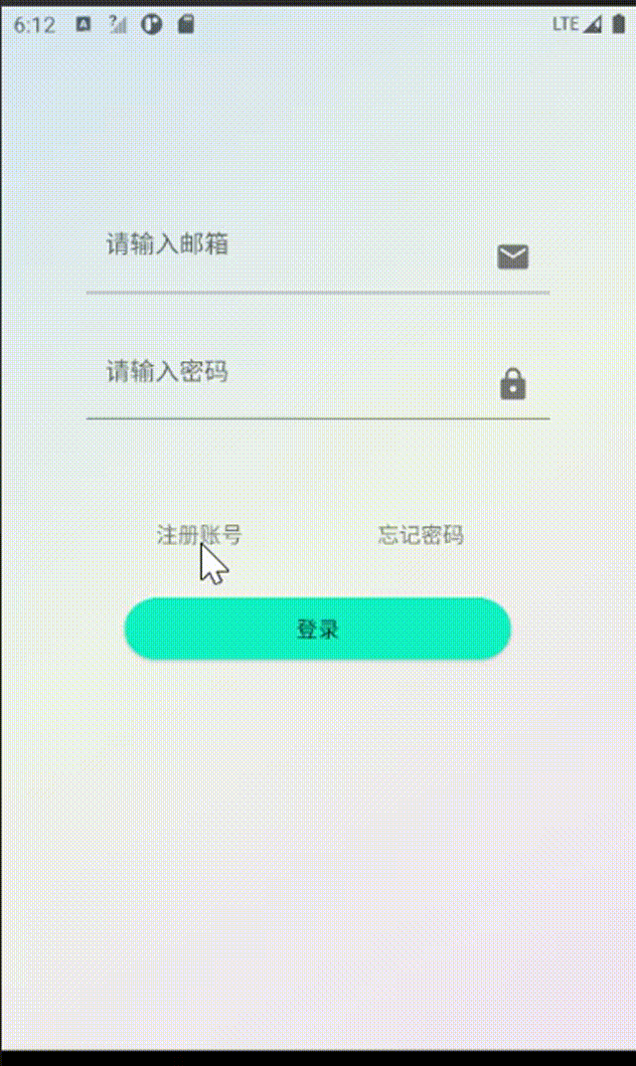
Demonstration
Resiger/
Login

Slide 22
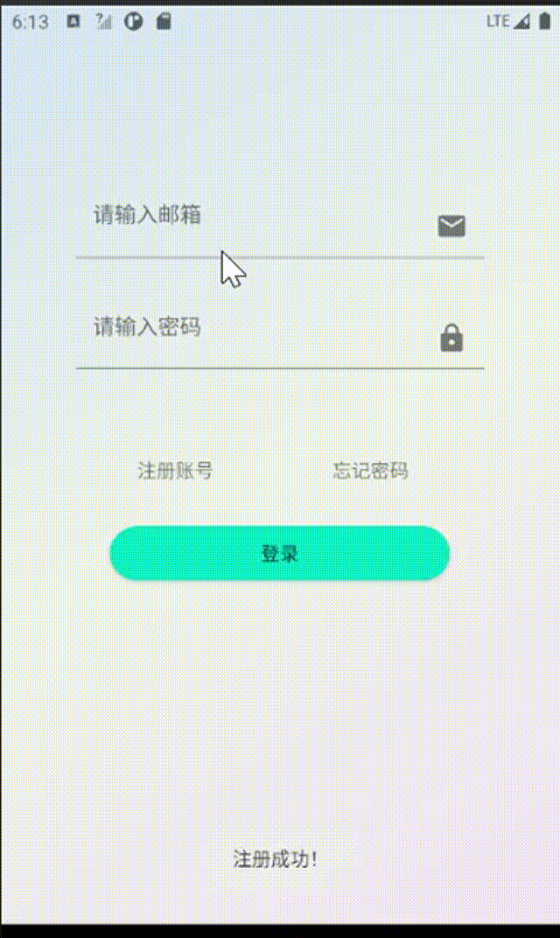
Demostrate
New user guide

Slide 23
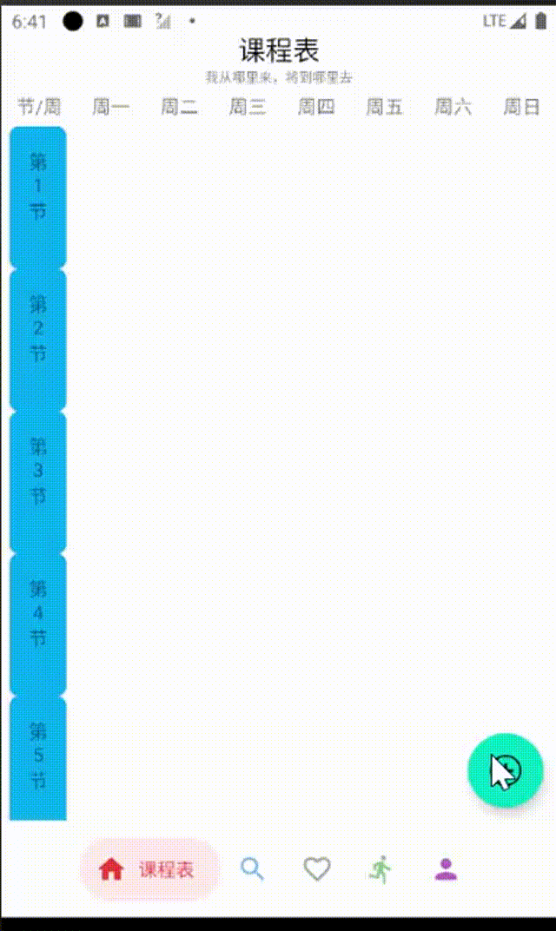
Demonstration
Class list

Slide 24
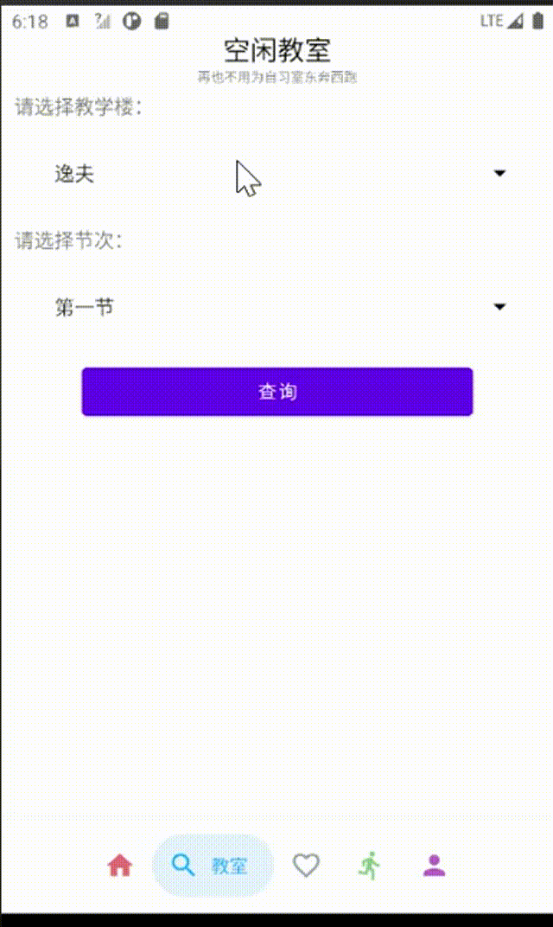
Demonstration
Spare classroom

Slide 25
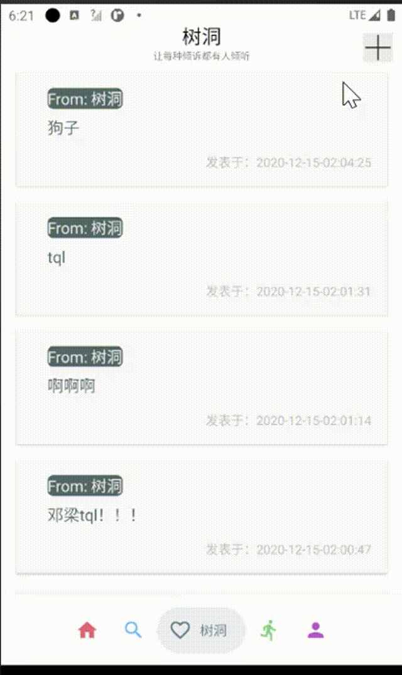
Demonstration
Tree hole

Slide 26
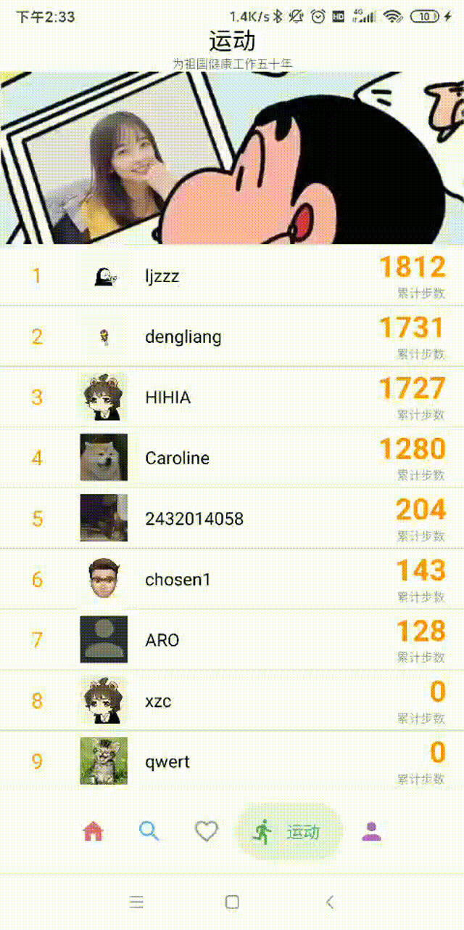
Demostrate
Steps ranking

Slide 27
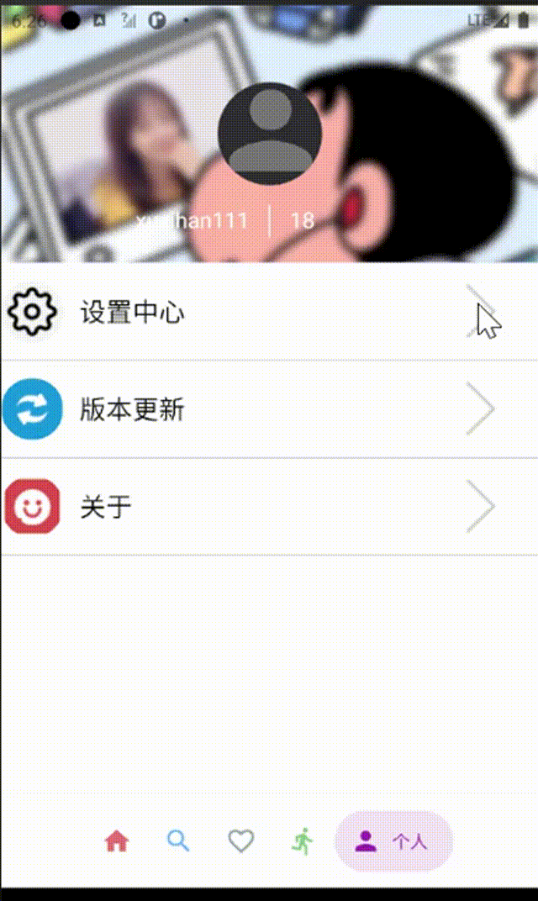
Demonstration
Personality

Slide 28
05
Summary

Slide 29



Summary
collaboration
hardworking

Slide 30
Summary

Slide 31
Future
optimize the entire project
launch more abundant functions
use our software
feedback

Slide 32
Thanks for listening
——from your Tongtong
Present by：Liang Deng | Zihan Zhou | Junze Li | Zihan Xu | Zicheng Xu | Rui Xing

